Slide 1
μProject - Iteration 2
By OneTeam:
David Blair
Christian Carducci
Juan Landaverde
Sang-Joon Lee
Jacqueline Pham
Srivathsa Rajagopal

Slide 2
Queued: Project Management Tool
Team | Landaverde, Lee, Rajagopal, Carducci, Pham
Features
Must haves
Create and manage users, projects, and stories
Manage story list (backlog, current, done, release)
Wants
Manage iterations
Assign story type
Nice to haves
Multiple projects
Search
View progress, history, and stories by individual
Prioritization via drag-and-drop
View of user owned stories
Email notification on due date
Archive projects, stories

Slide 3
ChatNow: Chat system
Team | Carducci, Blair, Landaverde, Rajagopal
Features
Must haves
Create a channel
Retain chat history
Wants
Send private messages
Search
Nice to haves
Share files
Audio/Video chat
Email Notifications
Archive/unarchive a channel
Online status of other users

Slide 4
Bugs: Issue Tracker
Team | Blair, Pham, Lee, Carducci
Features
Must haves
Create issues
Set priority, severity, and status of issue
Identify who reported issue
Wants
Comment on issue
Assign issue responsibility
Attach files to issue
Nice to haves
Tag and favorite issues
Link issue to Queued story
Maintain history
Custom fields
Filtering of issue list

Slide 5
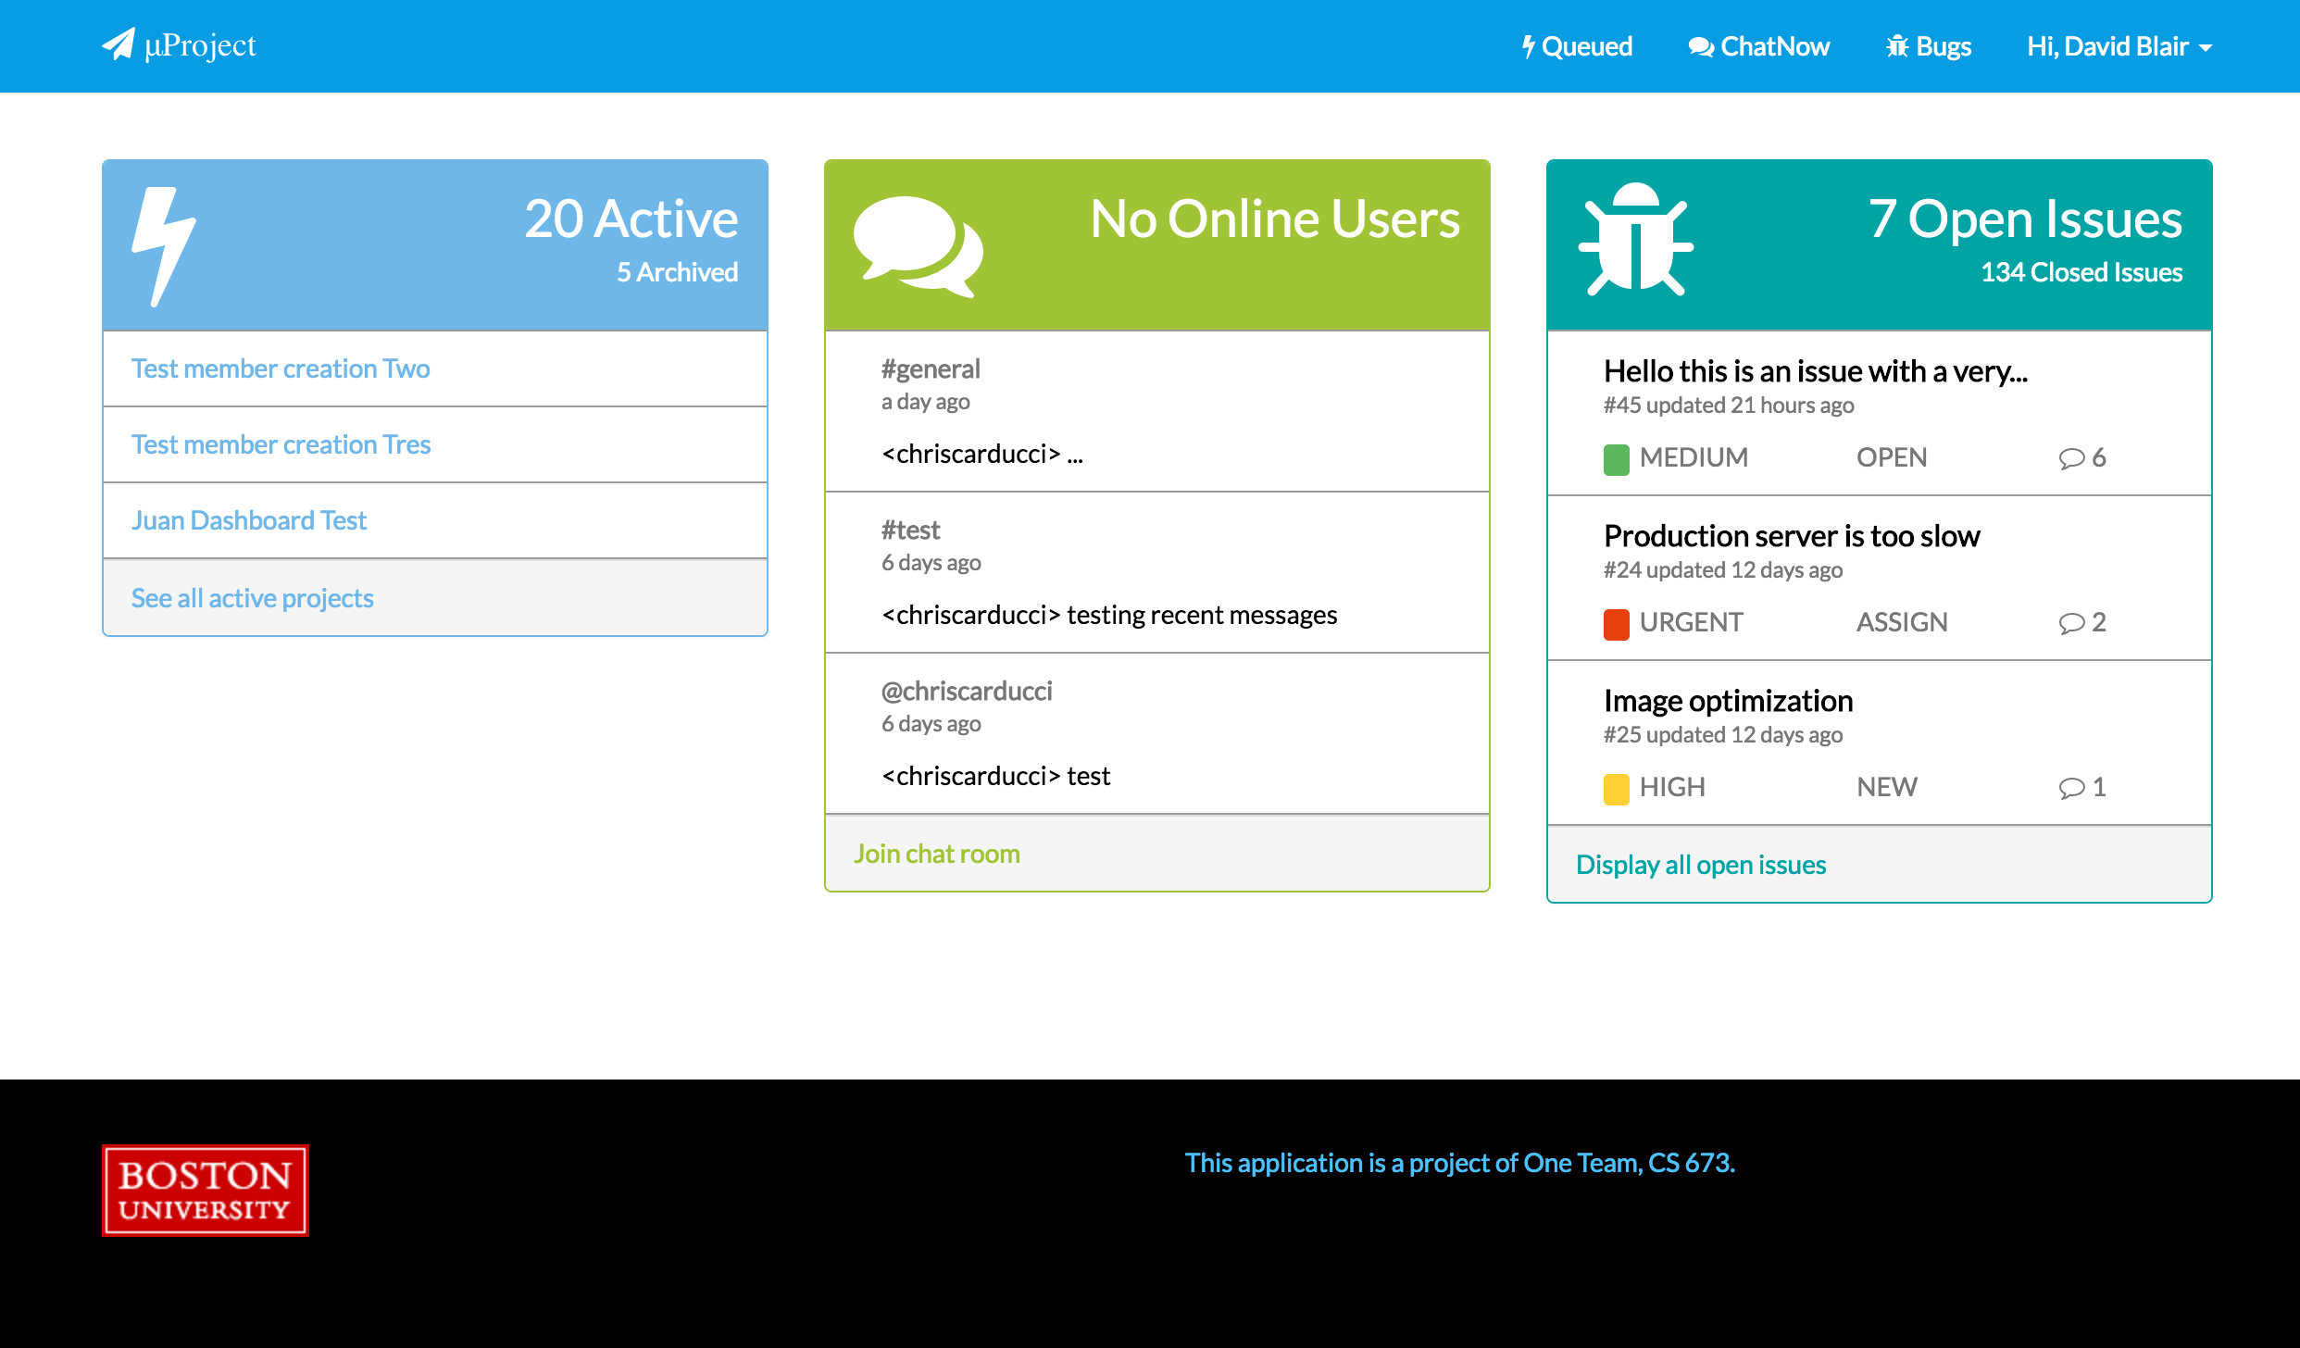
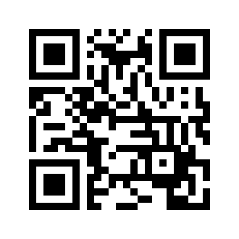
Demo
http://uproject.thirdelement.com

